Slide 1

NSTU Online Course Registration(NCR)

Slide 2






NSTU Online Course Registration
Developers
Mentor
Md. Mahbub Alam
[ASH1825003M]
Khair Ahammed
[ASH1825003M]
Dipanita Saha
Assistant Professor
Akash Chandra Debnath
[ASH1825003M]

Slide 3


Project Overview
Our project is about NSTU Online Course Registration. We build this project for several users like
Education Branch of NSTU
Students
Faculty Members
Section Officers etc.
In this system students can apply for their course registration in few minutes. After approval of the registration, students can pay his/her term fees.
This project can reduce time and cost of both parties and it is very effective for our education system also.

Slide 4







Project Objectives
Saving time
Reducing costs
Reducing uses of papers
Reducing data lost
Gathering data in few seconds

Slide 5


Stakeholders
Section Officer
Student
Education Branch
Register
Faculty Member
Course Coordinator
Hall Provost
Director/Chairman

Slide 6

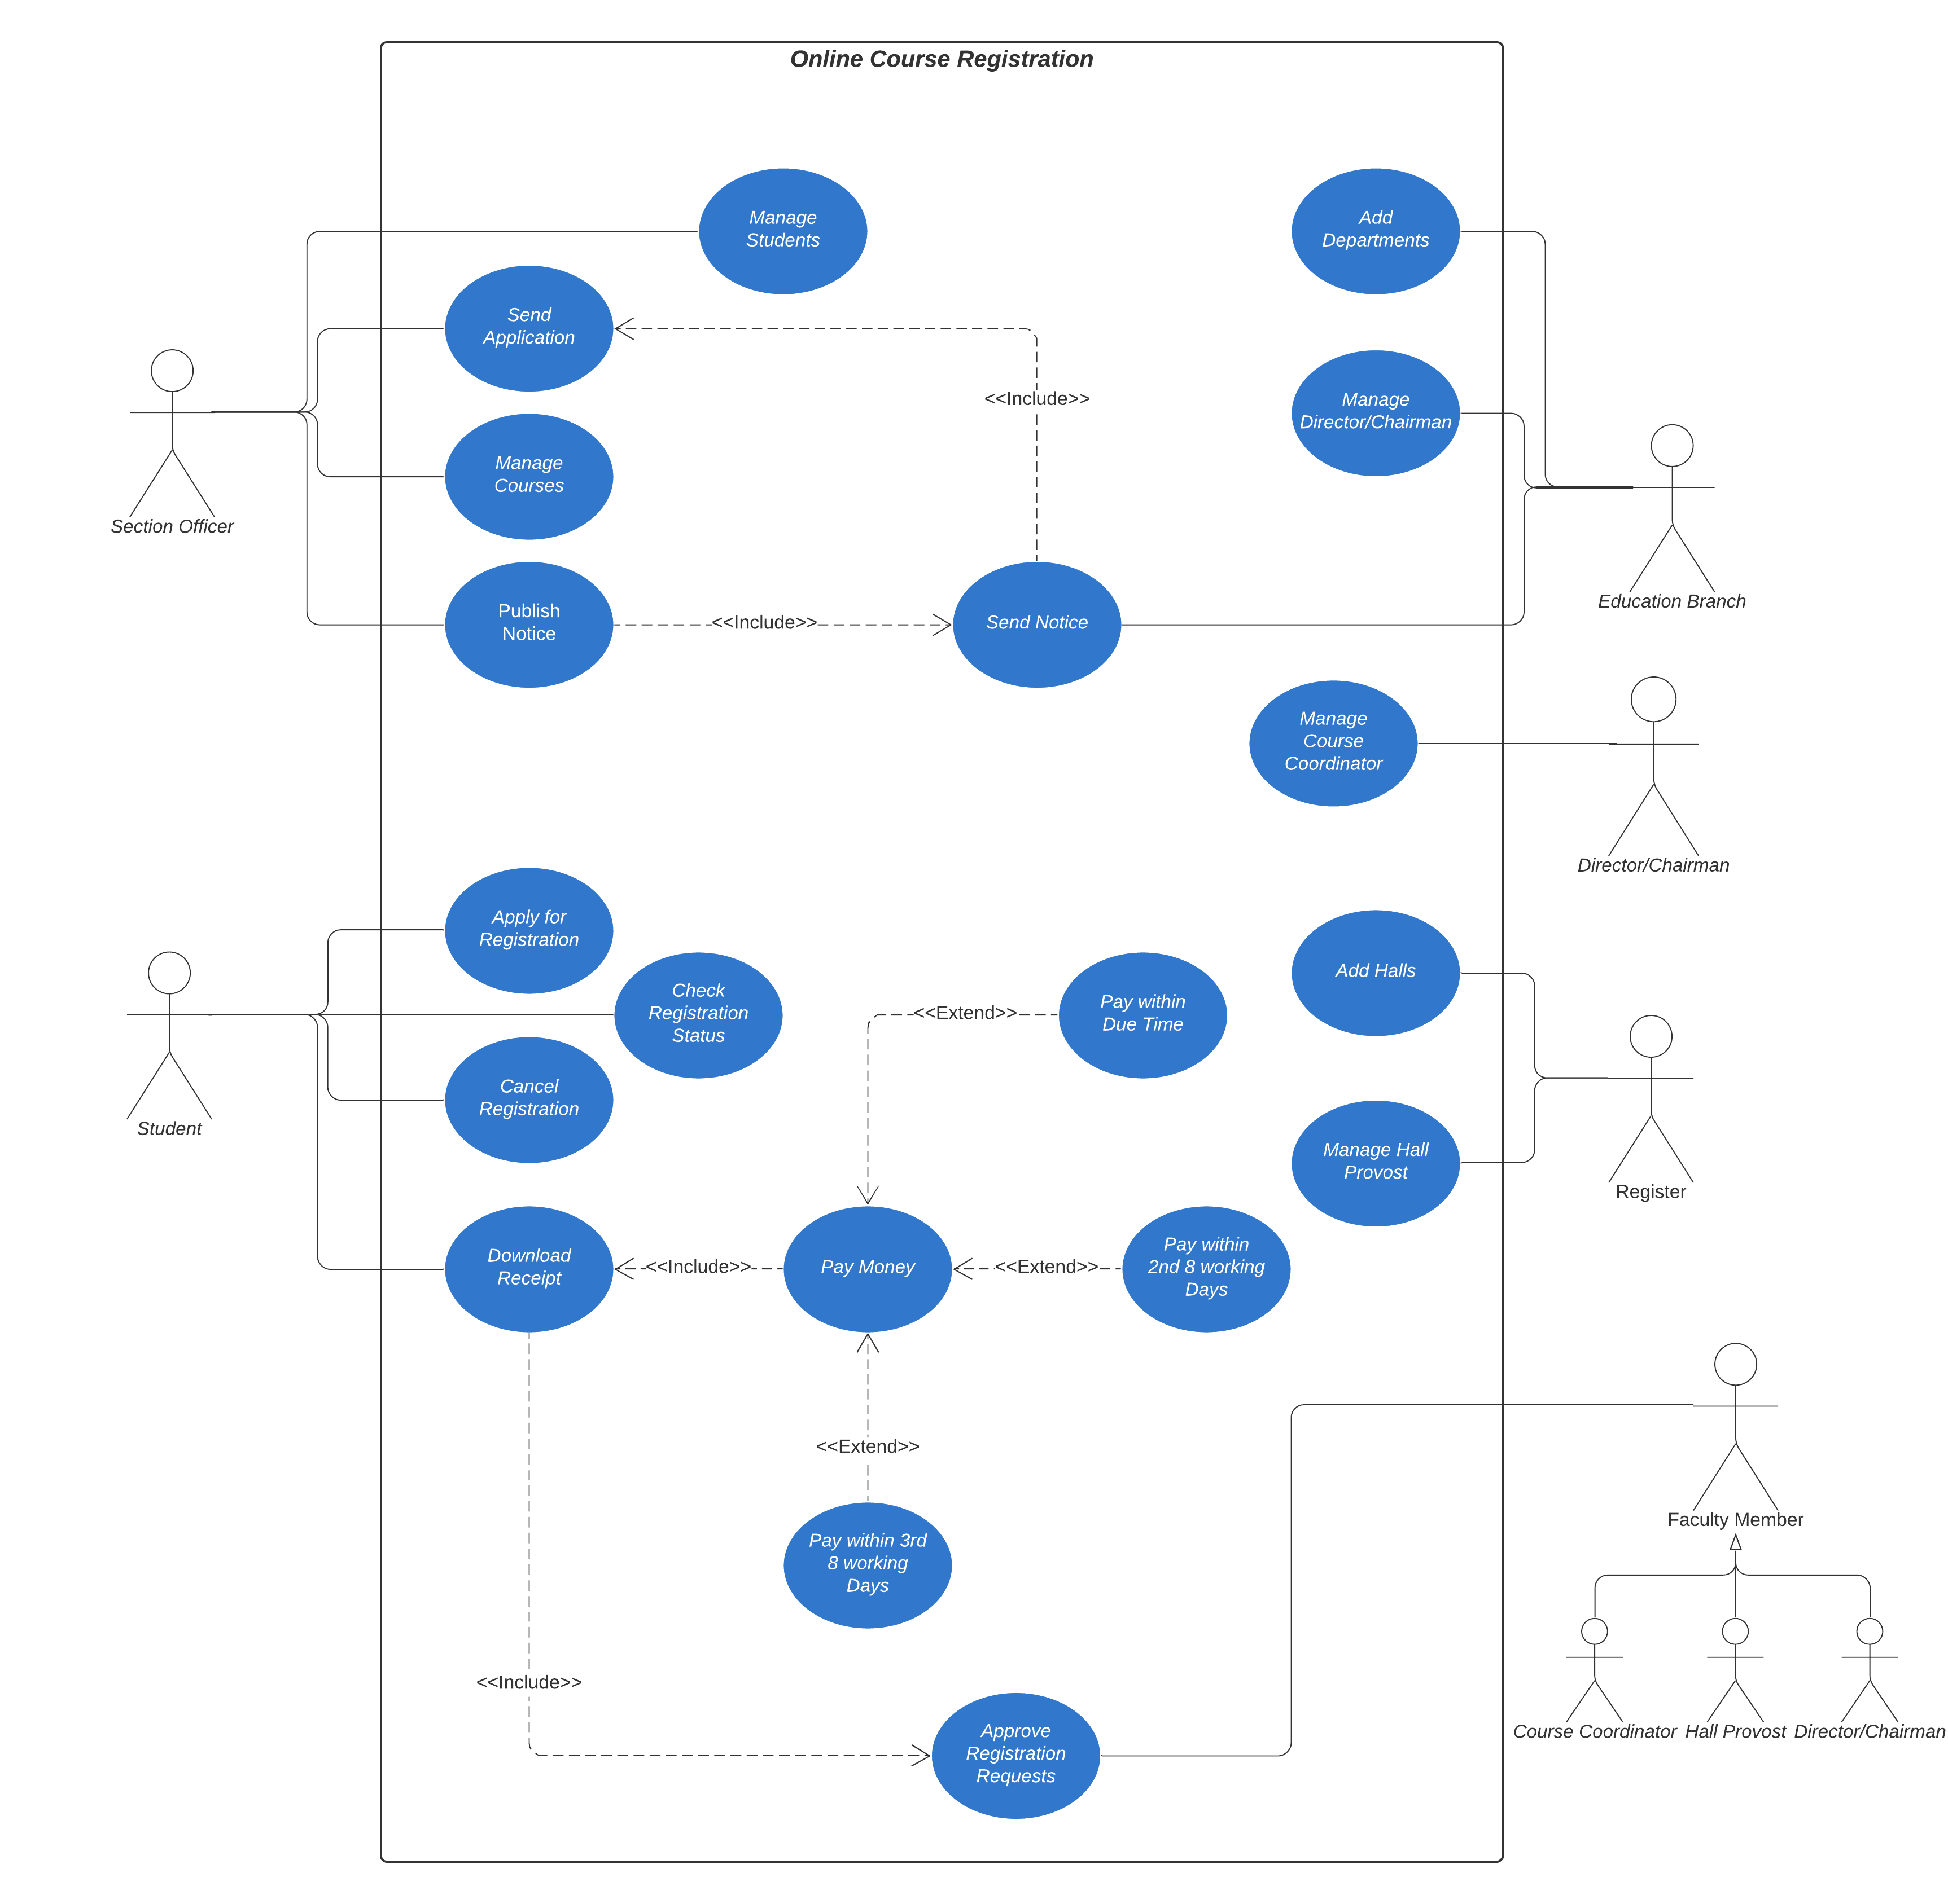
Use Case Diagram

Slide 7








Functional Requirements
Send Applications
Publish Notice about Course Registration
Apply for Course Registration
Approve Registration Requests
Download Term Fee Receipt
Pay Money within Due Time

Slide 8





Functional Requirements
In the system there needs to add
Departments
Faculty Members
Section Officer
Students
Courses
Moreover, users and the system must be managed with high priority.

Slide 9





Non-Functional Requirements
Availability and Reliability
Safety Requirements
System will be available 24/7 and reliable for the stakeholders
System will not contain any malware and will not harm stakeholders
Look & Feel Requirements
Security Requirements
System interface looks eye-catching and easy-to-use.
System is protected from any type of malicious attack

Slide 10
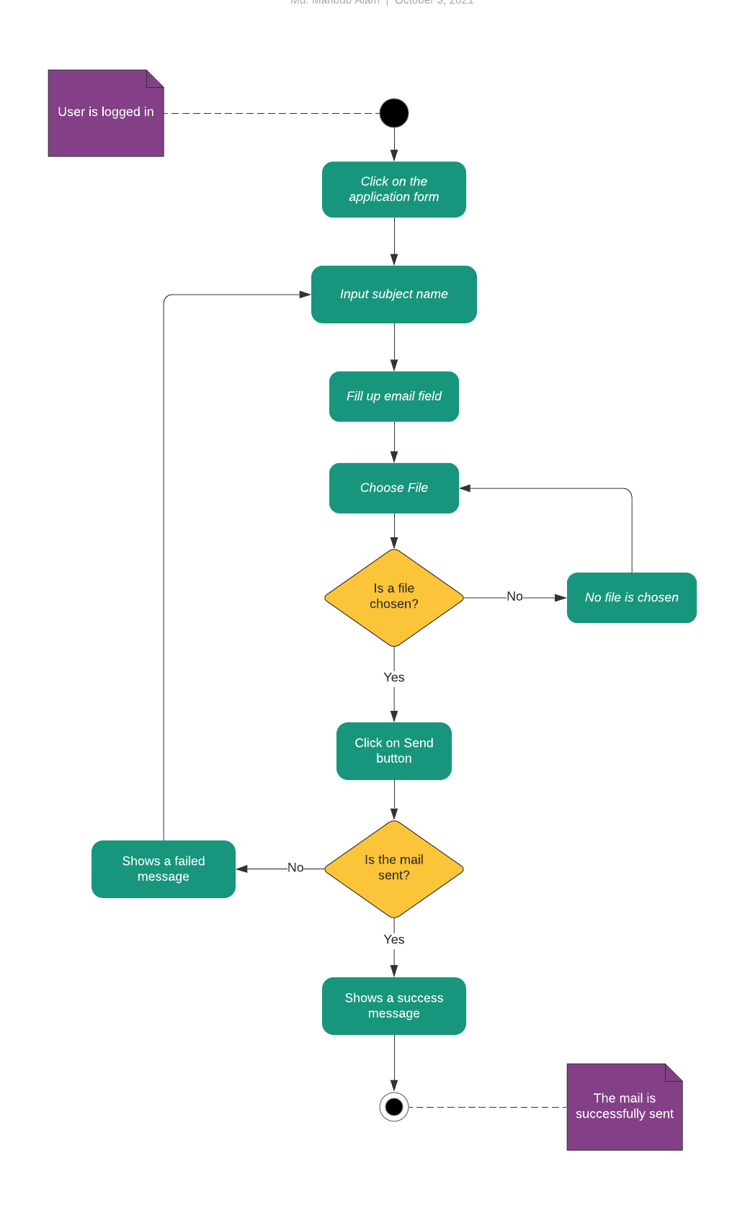
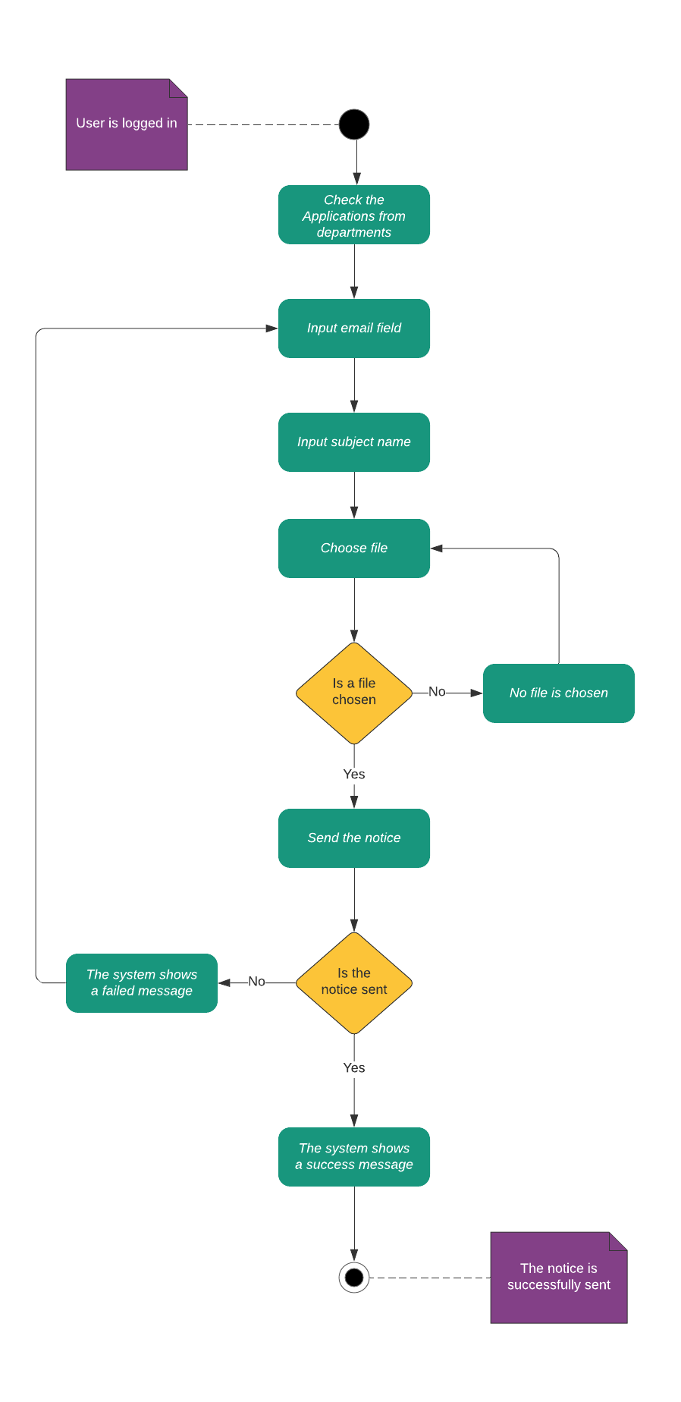
Some Activity Diagrams

Slide 11
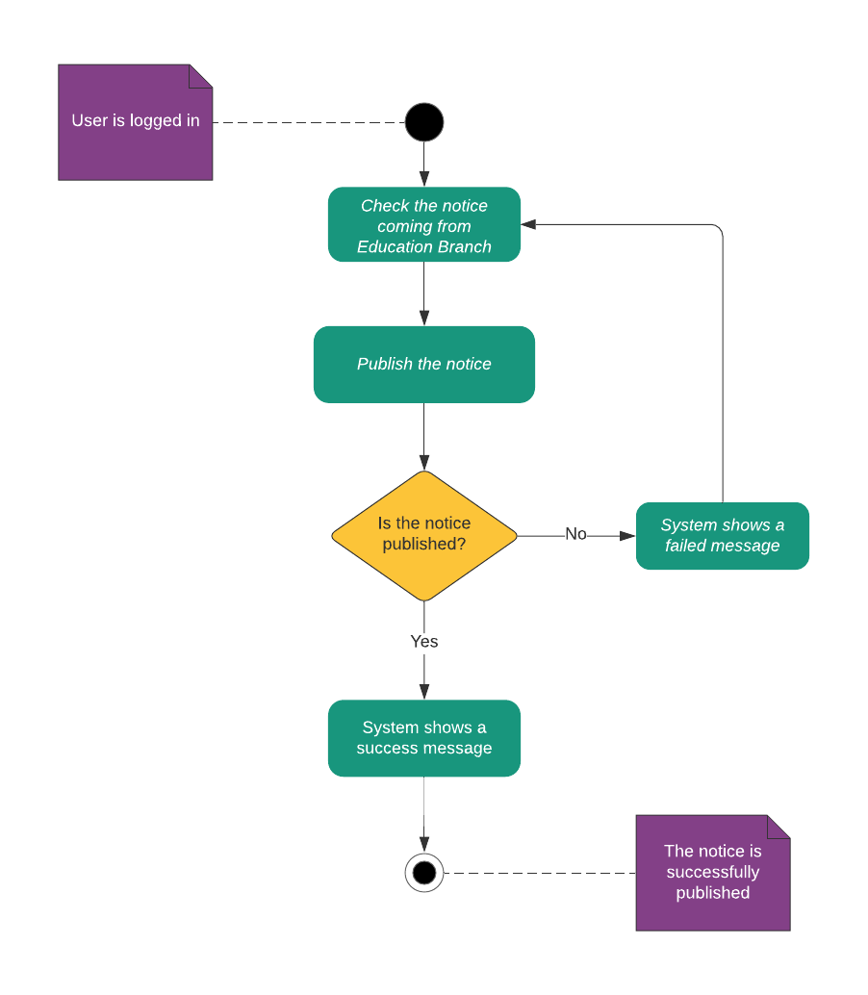
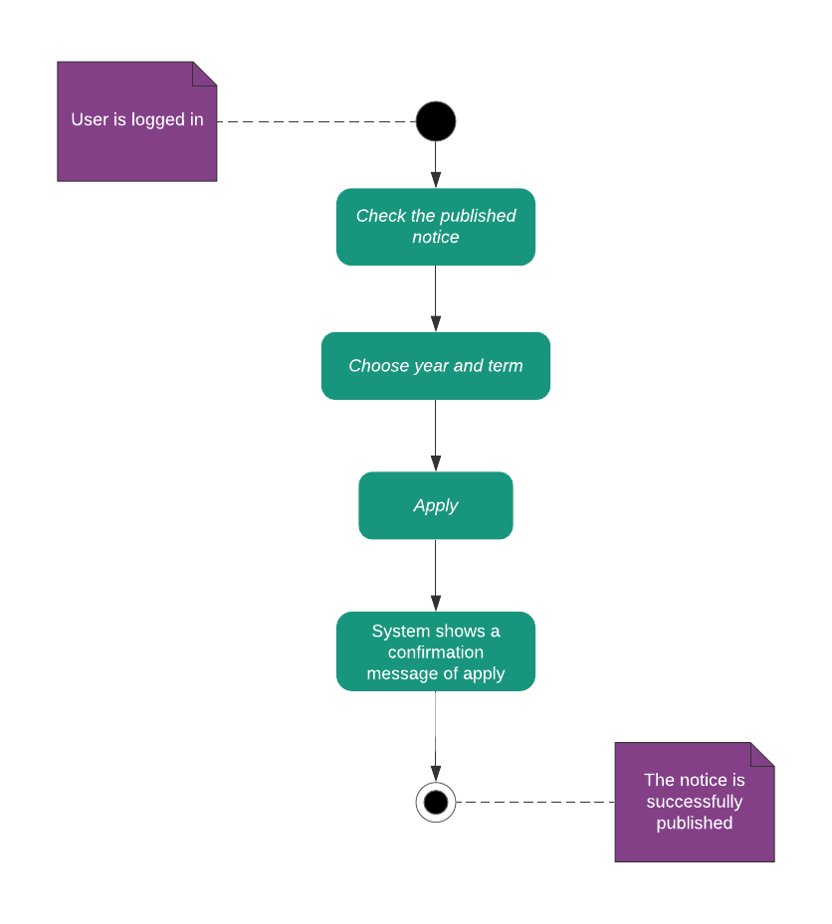
Some Activity Diagrams(Cont.)

Slide 12
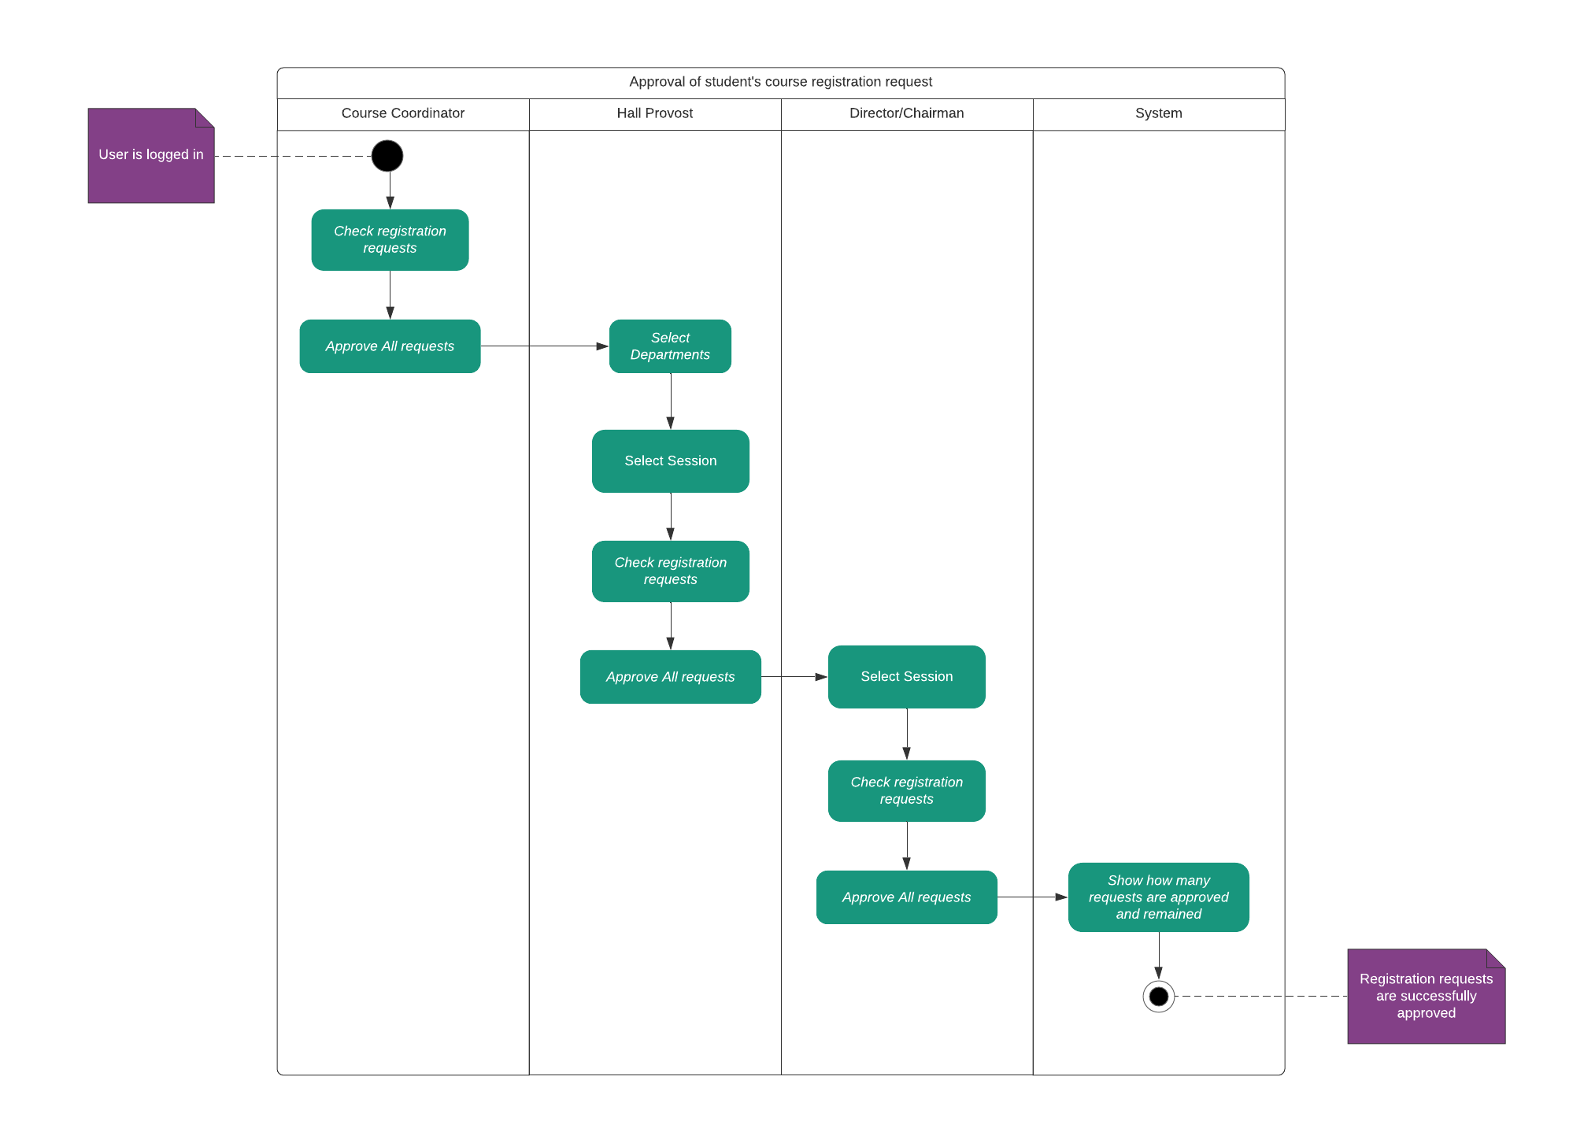
Some Activity Diagrams(Cont.)

Slide 13
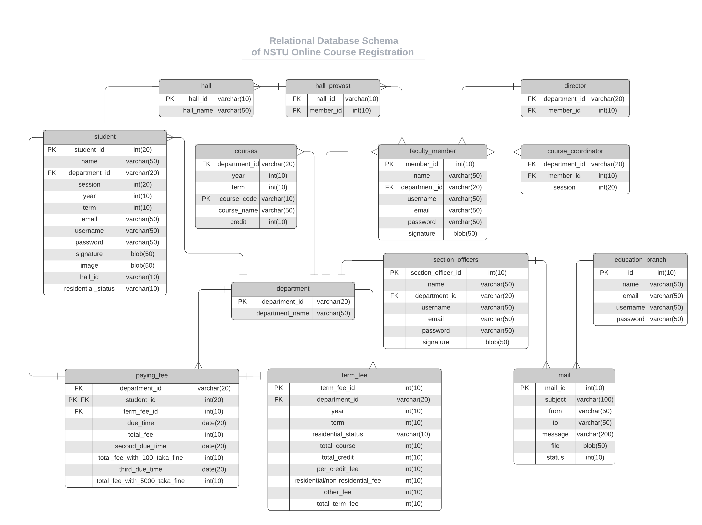

Slide 14


Elicitation Techniques
Interviews
Questions
There are two types of interviews,
Open Ended Interview
Structured Interview
We followed both of types of interview but we prefer Structured Interview.
For structured interview, we made some questionnaire.
What is the process of course registration?
How many types of users are involved in the course registration?
When does the course registration begin?
What problems generally face during course registration?
5. Who handle the course registration process?
6. How do students pay their course registration fees?
7. What steps are taken when a student can’t pay registration fees?

Slide 15

Elicitation Techniques(Cont.)
Observation
We need to observer the system of NSTU’s course registration system. There are so many complex system. We were observing that
When section officer pinned registration notice on the board.
How student fill-up their registration form.
When they pay term fees.
How section officer manage their registration system.
What problems are generally occurred in the course registration system.

Slide 16
Limitations
Not Fully Responsive
Email Verification Not Done
Limited Feature on Admin Panel
No online payment system

Slide 17




Future Works
Payment System will be added
Security System will be updated
Email Verification will be added
User feedback feature will be added

Slide 18







Tools and Resources
Frontend
Backend
Server

Slide 19

Thank You

